Slide 1
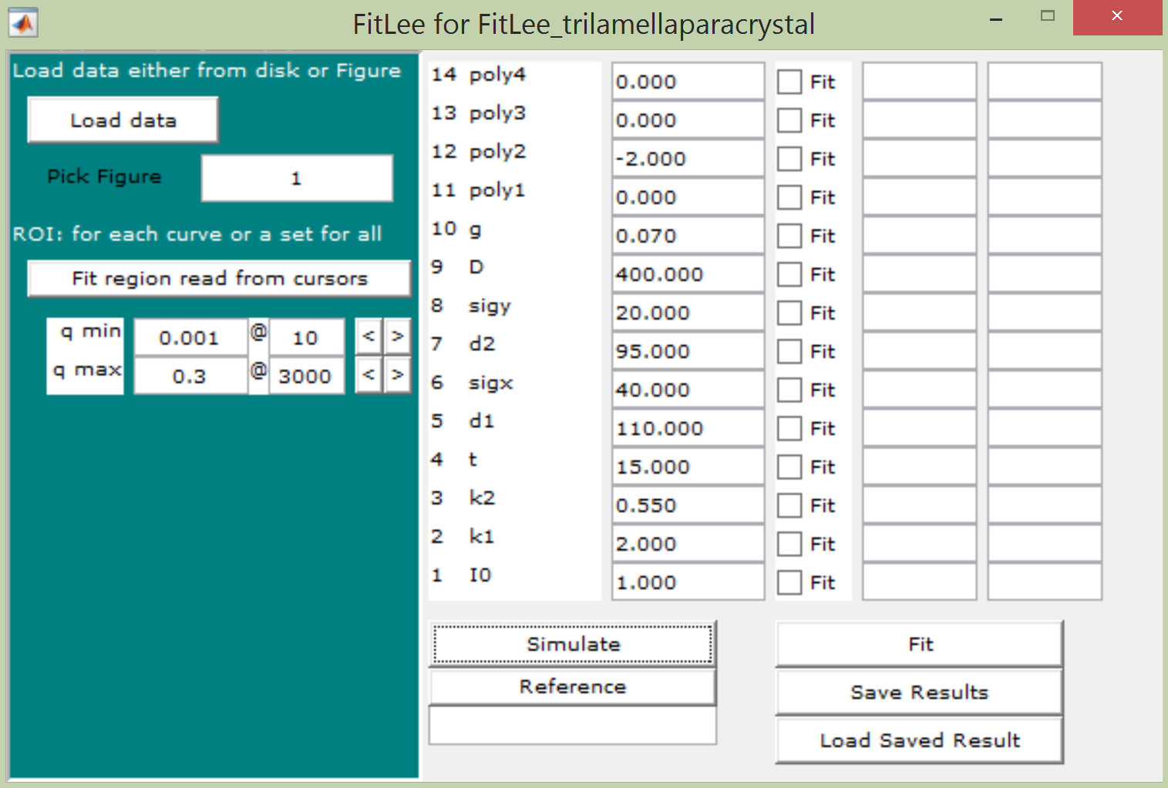
Procedure
1. Load data
2. put the q_min on box 1.
3. change q_max on box 2
4. Simulate
5. adjust fitting lowerlimit and upperlimit
6. Fit
7. If you want to save, put any filename on the box ‘save filename’ and click the ‘Save result’ button.
1
2
Fitting Lower Limit
Fitting Upper Limit
Save filename

